Slide 1


Slide 2



Internship/Project (3180701)
Review 2
Online Proctor System
GTU Team ID: 404478
Team Member 1: Parth Ahuja (200570107024) 8EC2
Team Member 2: Savan Pethani (200570107006) 8EC2
Guided By
Internal Guide Name: Prof. Samir Kariya
Department of Computer Engineering, FOE (057)

Slide 3
Outline
Introduction
Problem Statement
Abstract
System Analysis / Literature Review
Tools & Technology to be used
ER Diagrams
Use Case Diagrams
Activity Diagram
Proposed Solution / System
Project Flow Chart / System Design
Project Screenshot
Future Scope
Conclusion
References

Slide 4
Introduction
Our project introduction signals a bold leap into the future of online examinations, where state-of-the-art technologies converge to redefine academic integrity and efficiency. Our vision is clear: to craft a platform that not only combats cheating head-on but also sets a new gold standard for secure and dependable online assessments. By leveraging tools like OpenCV, NumPy, Flask, and sophisticated AI techniques including face recognition and audio detection, our aim is to forge a comprehensive solution that fortifies the sanctity of the examination process.
Through the lens of face recognition technology, we're poised to authenticate students' identities with unprecedented precision, drastically minimizing the risks associated with identity fraud or unauthorized access. Concurrently, our arsenal of audio detection algorithms stands vigilant, enabling real-time monitoring to swiftly flag any suspicious activities like illicit communication or unauthorized aids. Beyond just bolstering security, these features promise to streamline the proctoring process, ensuring a seamless testing experience for both educators and students alike.
Looking ahead, the ripple effects of our project extend far beyond the present moment. As we pioneer the integration of AI-driven technologies in online assessments, we anticipate a seismic shift in global examination practices. Our aspiration is to arm educational institutions with a scalable, trustworthy solution that upholds the loftiest standards of fairness and integrity. Ultimately, our endeavor seeks to carve out a new path for online education—one where trust, security, and innovation intertwine to forge a more equitable learning landscape for all.

Slide 5
Problem Statement
Lack of Integrated Solutions: Existing facilities fail to offer an integrated solution, resulting in fragmented systems that hinder efficiency and user experience.
Inefficiency with Scale: As the number of students taking exams increases, traditional monitoring systems prove to be inefficient, struggling to handle the volume effectively. This inefficiency leads to delays, errors, and frustration among users.
Infrastructure Overload: Institutions equipped with their own servers and infrastructure face challenges during peak times, such as exams, as their systems are unable to cope with sudden surges in user traffic. This often results in system crashes, causing disruptions and compromising the integrity of the examination process.
By addressing these issues, we aim to develop a comprehensive solution that not only integrates various functionalities but also scales effectively to meet the growing demands of educational institutions.

Slide 6
Abstract
Our project proposes an innovative Online Proctoring System to address the challenges of remote examinations in digital education. This system integrates various technologies to ensure fairness and maintain the credibility of online education, addressing the unique challenges of remote examinations.
The COVID-19 pandemic has accelerated the rise of online education, leading to a surge in Massive Open Online Courses (MOOCs). This has created challenges in maintaining the integrity of online assessments. A new project introduces an Online Proctoring System, a multimedia analytics platform, to address these issues.
The Online Proctoring System is a groundbreaking tool that collects audio-visual data during exams, uses advanced algorithms to detect cheating, and features a 360-degree security camera. It prioritizes examination integrity by analyzing cognitive, artistic, and technological parameters.
Our project addresses concerns about AI-based proctoring systems by proactively addressing student privacy and data security, ensuring ethical use of collected data, and alleviating concerns among the student community.

Slide 7
System Analysis / Literature Review
Since the schooling business is encountering major reform with arising innovations, instructive organizations to lead semester end and selection tests distantly. While many schools are closed amid the COVID-19-episode, numerous colleges have started assessments that students can work using web technology [1].
G. Cluskey, et al. presented a paper on online exam cheating without proctor supervision. This work shows how remote proctoring can help to prevent cheating during online exams [2].
Bodiwala, S., Nanavati, N. suggested an efficient stochastic computing-based DNN accelerator with optimized activation functions. This work is noteworthy in face detection [4].
Jain, V., Jain et al. worked on Sign Language detection using AI. They have used multiple techniques to recognize sign gestures students make during online classes [5].

Slide 8
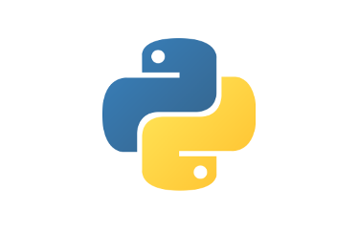









Tools & Technology to be used
Python
Flask
OpenCv
Numpy
TensorFlow
SQLite
HTML
JavaScript
CSS
React
AI Models

Slide 9
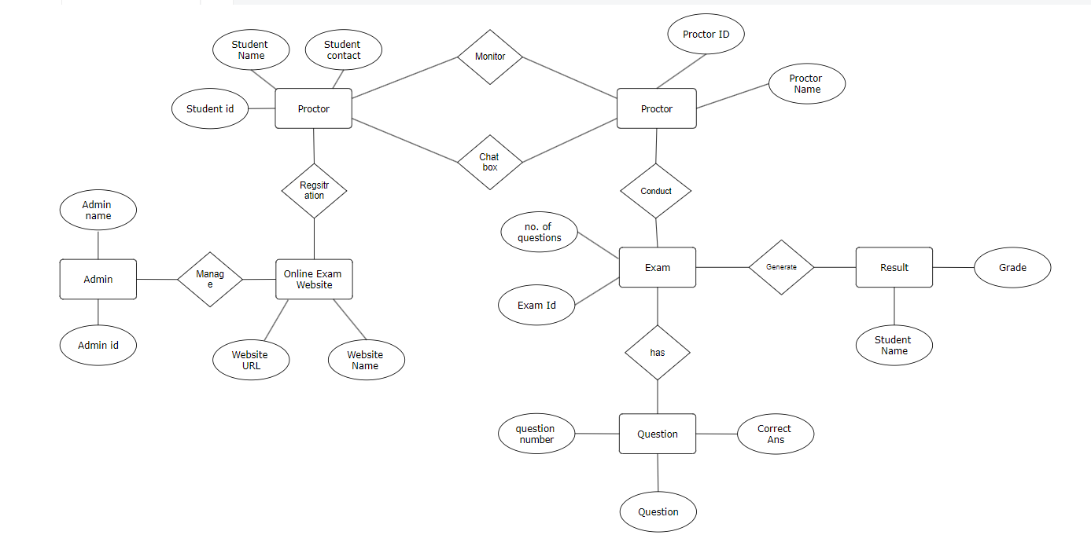
ER Diagram
ER Diagram

Slide 10
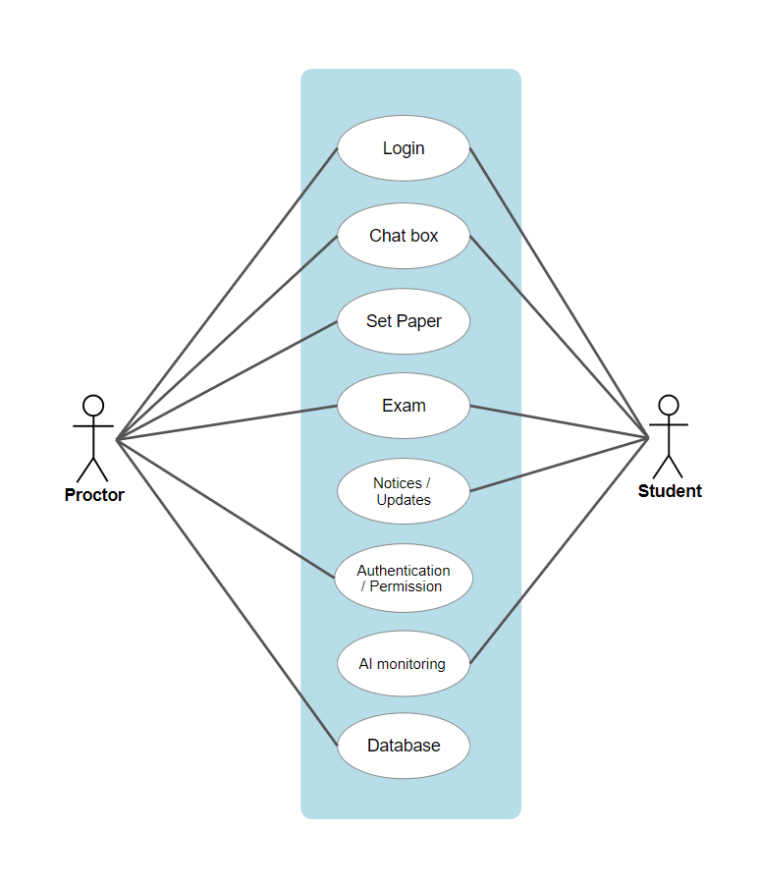
Use Case Diagram
Use Case Diagram

Slide 11
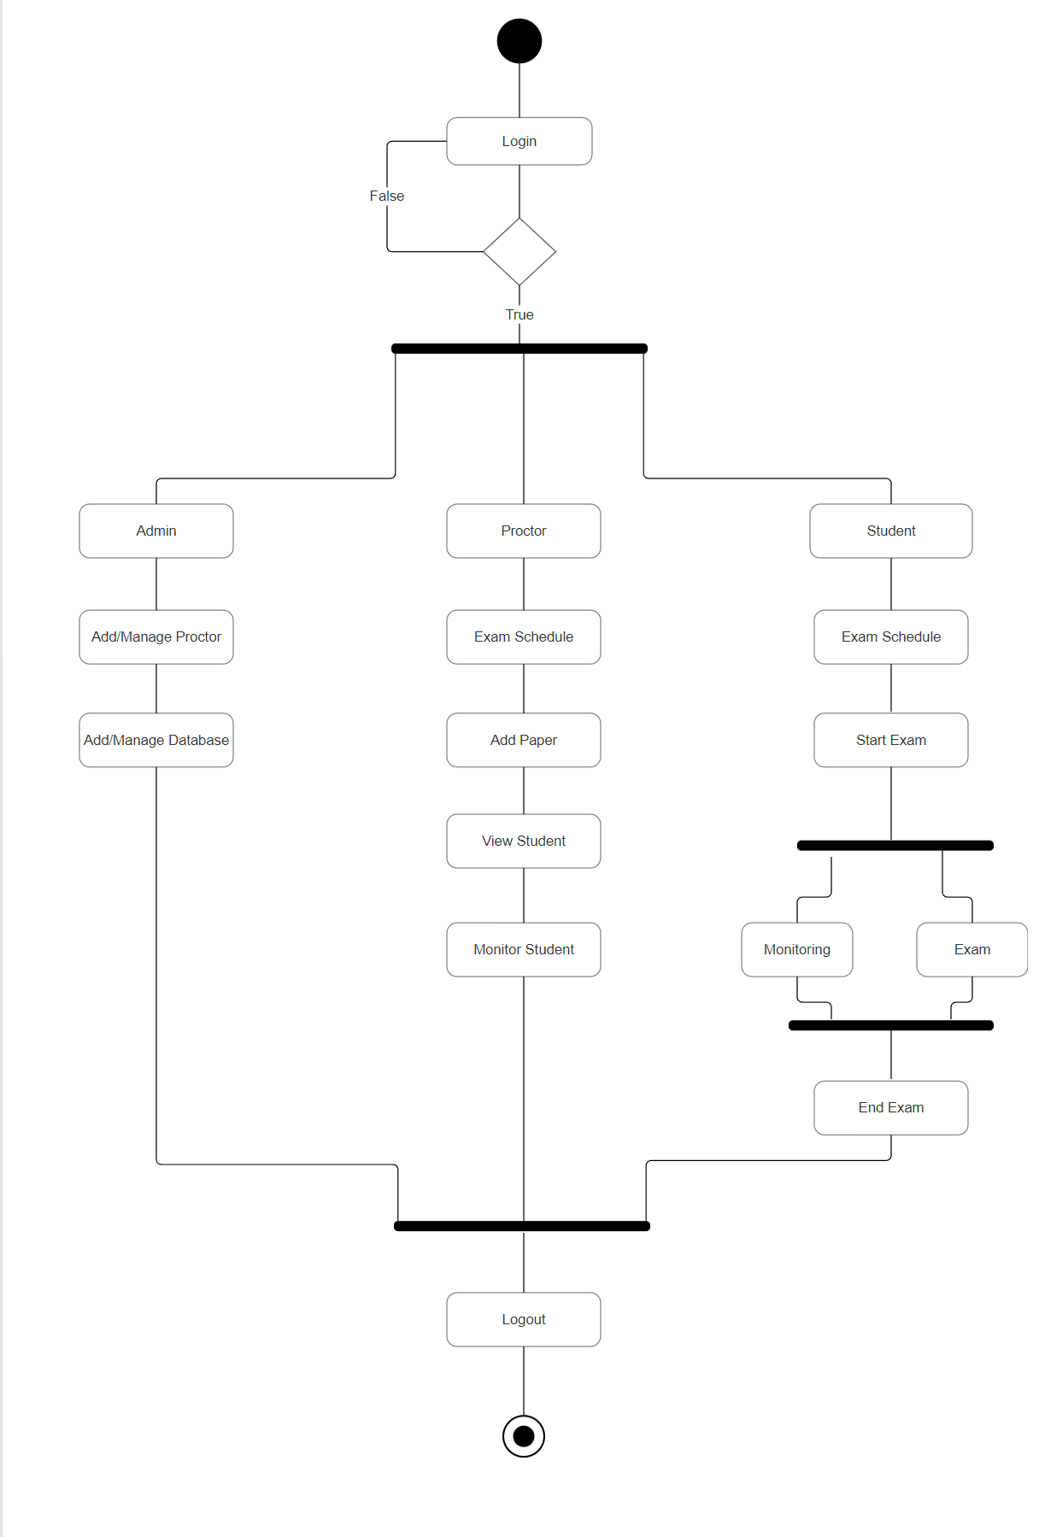
Activity Diagram
Activity Diagram

Slide 12
Proposed Solution
Our online exam application is designed to combat cheating by leveraging advanced AI technologies. Through features like face recognition and audio detection, we authenticate students' identities and monitor their behavior in real-time during exams. This proactive approach ensures a secure testing environment, minimizing the risk of unauthorized assistance or impersonation. By incorporating sophisticated algorithms for behavior analysis, we can swiftly detect any irregularities and intervene when necessary, upholding the integrity of the examination process.
Furthermore, our system prioritizes data security by employing robust encryption protocols to safeguard exam content from potential breaches or tampering. This not only protects the confidentiality of assessments but also maintains trust between educators and students. With the increasing reliance on online platforms for academic assessments, our solution offers a reliable and scalable approach to preserving academic integrity.
Overall, our online exam application represents a significant step forward in ensuring fair and reliable assessments in the digital age. By combining innovative AI technologies with stringent security measures, we provide a comprehensive solution that fosters trust and confidence among all stakeholders involved in the examination process.

Slide 13
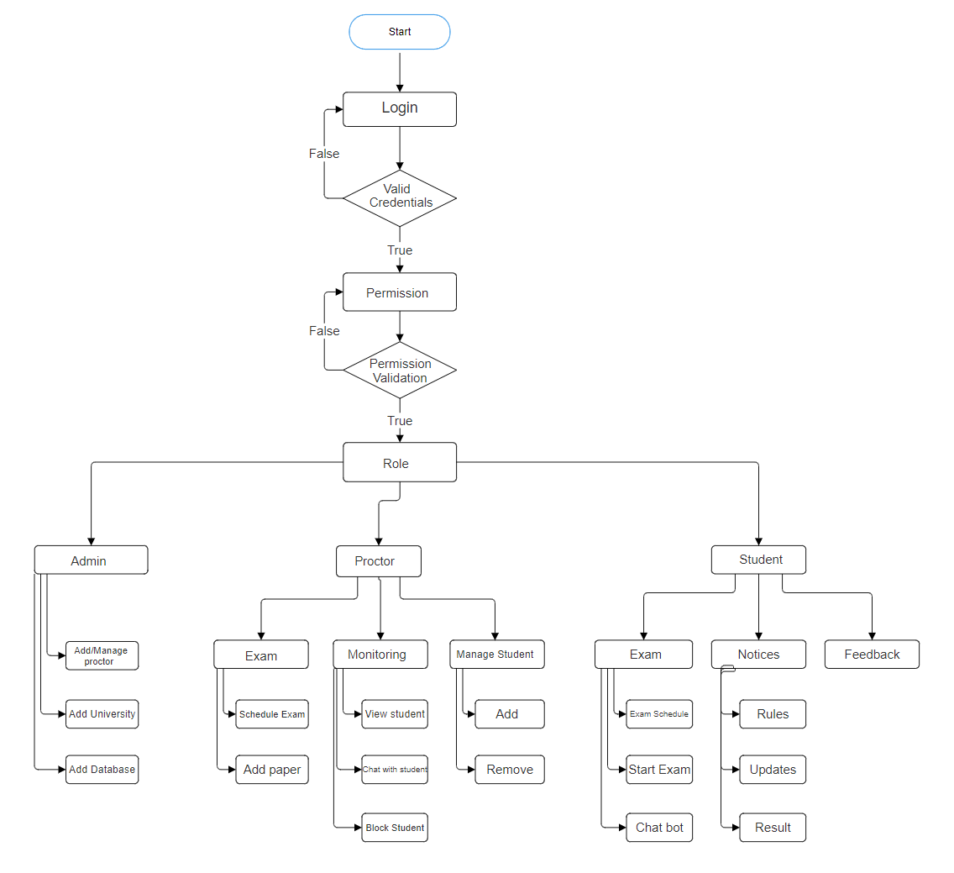
Project Flow Chart / System Design
Flow Chart

Slide 14

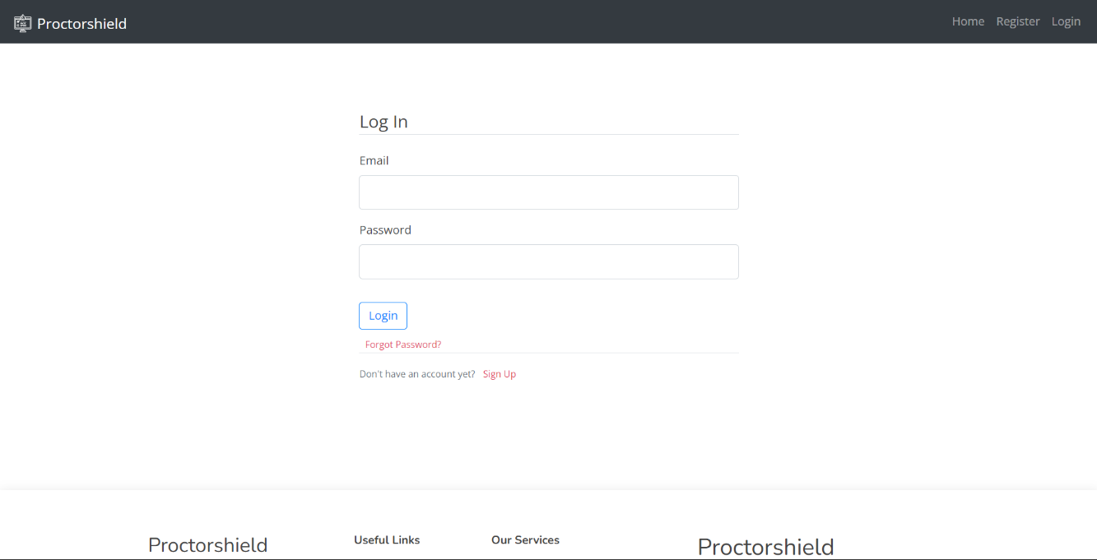
Project Screenshot
Home Page
Login Page

Slide 15
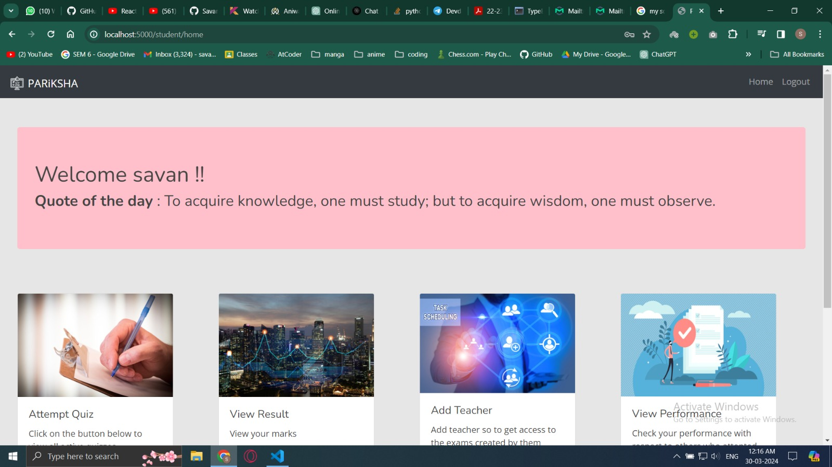
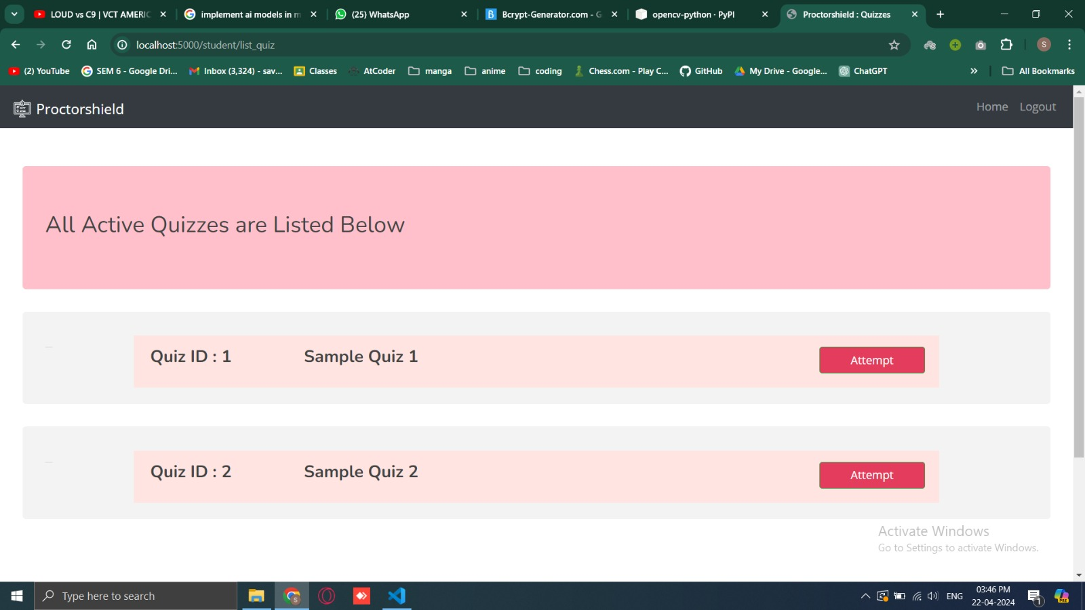
Project Screenshot
Dashboard Page
Quiz Page

Slide 16
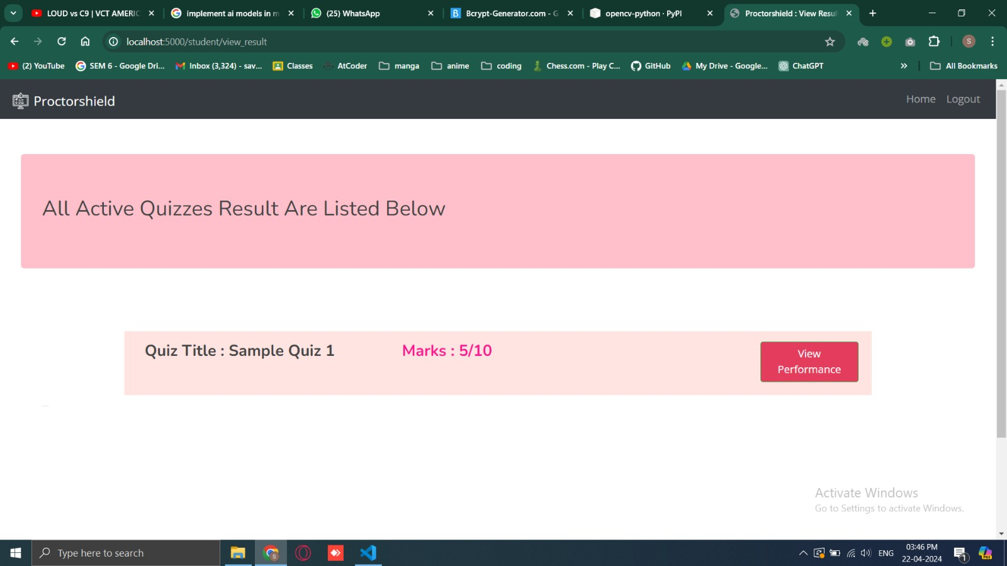
Project Screenshot
Result Page
Quiz Page

Slide 17
Project Screenshot
Integration of Additional AI Models: Future updates may incorporate voice recognition and keystroke analysis alongside facial recognition to enhance detection of suspicious behavior during exams.
Enhanced Proctoring Tools: Development efforts will focus on advanced monitoring features like gaze tracking and biometric authentication, along with automated anomaly detection and customizable alert systems for proctors.
Integration with Learning Management Systems (LMS): Strengthening integration with LMS platforms like Moodle and Canvas will streamline exam scheduling, grading, and data management for educators while improving accessibility for students.
Expansion to Mobile Platforms: Plans include developing dedicated iOS and Android apps to accommodate mobile learning trends, allowing students to take exams conveniently on their smartphones or tablets, thereby promoting accessibility and flexibility in education.

Slide 18
Conclusion
The "Online Proctoring Exam Application" is a state-of-the-art web-based platform designed to redefine the landscape of remote examinations. By integrating advanced AI technology, real-time monitoring capabilities, and a streamlined user experience, the application aims to significantly enhance the security, integrity, and efficiency of online exams. With features such as AI-powered suspicious activity detection, live monitoring by proctors, and instant communication between proctors and students, the application provides a comprehensive solution for conducting secure remote examinations. This project seeks to address the limitations and challenges associated with traditional online exam systems, offering a reliable and user-friendly platform that meets the needs of both educators and students alike.

Slide 19
References
[1] “An intelligent system for online exam monitoring,” IEEE Conference Publication | IEEE Xplore, Aug. 01, 2016. https://ieeexplore.ieee.org/abstract/document/7845315/
[2] “Automated online exam proctoring,” IEEE Journals & Magazine | IEEE Xplore, Jul. 01, 2017. https://ieeexplore.ieee.org/abstract/document/7828141/
[3] T. S. Kumar and G. Narmatha, “Video analysis for Malpractice Detection in classroom examination,” in Advances in intelligent systems and computing, 2015, pp. 135–146. doi: 10.1007/978-81-322-2671-0_13.
[4] L. C. O. Tiong, “E-Cheating Prevention Measures: Detection of cheating at online examinations using deep learning approach -- a case study,” arXiv.org, Jan. 25, 2021. https://arxiv.org/abs/2101.09841
[5] “On continuous user authentication via typing behavior,” IEEE Journals & Magazine | IEEE Xplore, Oct. 01, 2014. https://ieeexplore.ieee.org/abstract/document/6879297
[6] Y. Zhang, X. Liu, M.-C. Chang, W. Ge, and T. Chen, “Spatio-Temporal phrases for activity recognition,” in Lecture Notes in Computer Science, 2012, pp. 707–721. doi: 10.1007/978-3-642-33712-3_51.

Slide 20


